Slide 1
Predicting Student Stress: Analytical Perspectives and Implications
Prabhu Narayan Singh (MY.AC.P2MCA23038)

Slide 2


Introduction
The health and safety of students is becoming more and more of a worry in today's busy and difficult school setting. Stress in particular has become a big problem for students' health and ability to do well in school. Students often feel very stressed because they have to do well in school and also deal with social and personal problems. It's important for educators, policymakers, and mental health experts to understand how the many things that cause student stress affect each other.
This study paper starts a thorough investigation of student stress by using predictive modelling to guess how much stress there will be based on many different factors. By delving into factors such as anxiety, sleep deprieved, self-esteem, mental health history, academic success, and social support, among others, this study attempts to unravel the complex dynamics shaping student .

Slide 3

Data related to stress in indian students
A 2017 survey by the National Sample Survey Office (NSSO) found that around 20% of students aged 15-29 reported feeling stressed due to academic pressure
A 2019 study by the National Institute of Mental Health and Neurosciences (NIMHANS), around 10-15% of Indian students suffer from mental health issues, with stress being a major component.
A study published in the Indian Journal of Psychological Medicine in 2020 found that 50% of students reported high levels of stress, with factors such as academic workload, parental expectations, and fear of failure contributing to their stress.
In a survey conducted by the Associated Chambers of Commerce and Industry of India (ASSOCHAM) in 2018, 68% of students cited parental pressure as their primary stressor.

Slide 4
Literature Review
1. Stress Detection via Google Forms and Machine Learning: This paper uses Google Forms, EDA, and machine learning algorithms to detect student stress. It highlights stress prevalence and correlates, offering insights for targeted interventions and reinforcing the role of machine learning in promoting student well-being.
2. Coping Mechanisms for Nursing Students' Academic Stress: This study examines academic stress and coping mechanisms in 196 nursing students at St. Michael's College. It emphasizes tailored stress management programs, addressing workload and time management, and recommends fostering peer connections and self-care techniques.
3. Predicting Academic Performance with Machine Learning: The study uses SVM and Naïve Bayes to predict academic performance. It discusses data handling and the significance of student determination, reinforcing machine learning's role in educational outcomes and performance predictions.
4. Impact of Stress on Academic Performance and Psychological Well-being: This paper reviews student stress studies, focusing on academic performance and well-being impacts. It identifies common stressors and coping strategies, providing a theoretical foundation for understanding and mitigating student stress.
5. Link Between Academic Stress, Gratitude, and Student Well-being: This study links academic stress, gratitude, and well-being among Madrasah Aliyah students. It finds stress negatively impacts well-being, while gratitude fosters positive outcomes, advocating for interventions that address stress and promote gratitude.

Slide 5
Research Gap
Many researchers have not taken sleep, bullying in consideration for stress. Which in our opinion can be the biggest cause of Stress.
Lack of real-time assessment methods for current stress levels, indicating a need for tools to monitor and address student stress dynamically during the pandemic.
Lack of exploration into integrating other machine learning algorithms or hybrid models to improve prediction accuracy in academic performance.

Slide 6
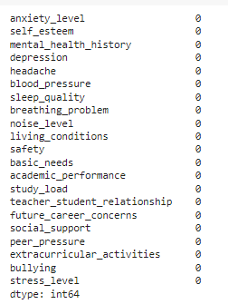
Methodology
Data Collection:
The dataset includes anonymized responses from students across various educational institutions.
Data was collected from the open repository ‘Kaggle’.
Includes variables such as student stress, anxiety levels, self-esteem, mental health history, academic performance, and social support.
Data Preprocessing:
Steps ensure data quality and suitability for predictive modeling.
No preprocessing was required as there were no missing values or outliers.
3.CLUSTERING
A data mining technique called clustering is used to put data points in one group according to their commonalities. Investigating hidden patterns is beneficial within the dataset. The dataset was narrowed down to only two features : Tumor size and Outcome. Unsupervised machine learning called K-Means clustering groups a predetermined number of clusters (K). Its main goal is to reduce the separation between data points inside a cluster and centroids, or central points. Euclidean distance was the distance measure that was used.
4.CLASSIFICATION
Classification is a supervised learning task in machine learning and statistics where the objective is to predict the categorical labels of new instances based on past observations. Each instance is described by a set of features, and the goal is to assign it to one of the predefined categories or classes.

Slide 7
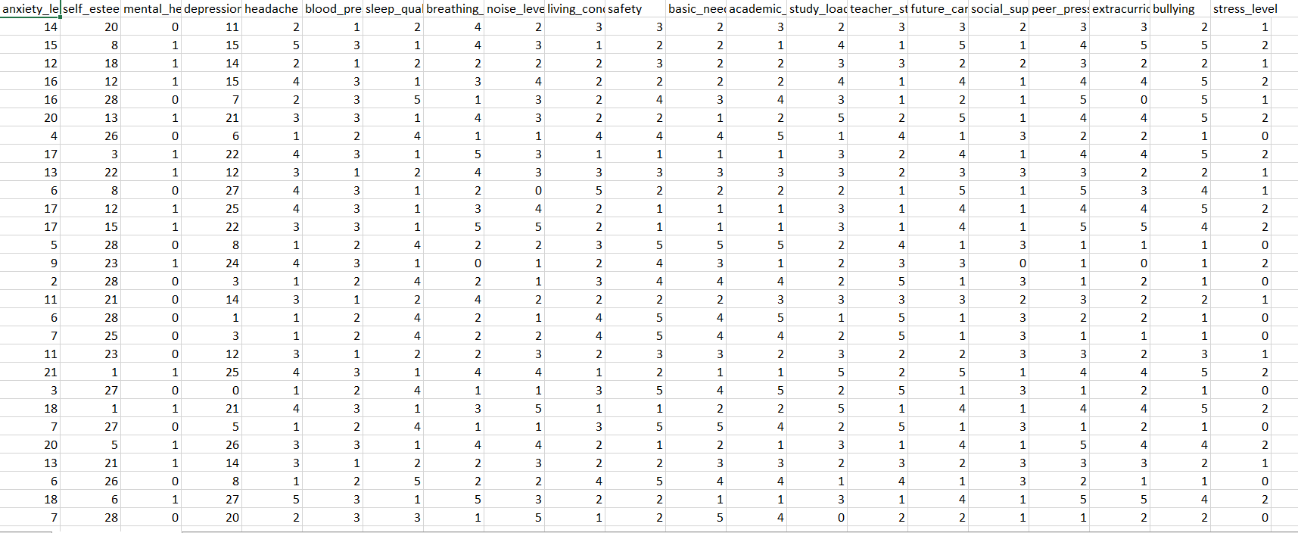
Data set

Slide 8
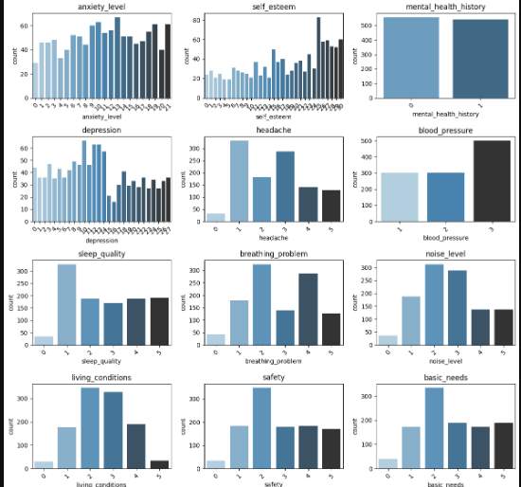
Representation in bar chart

Slide 9
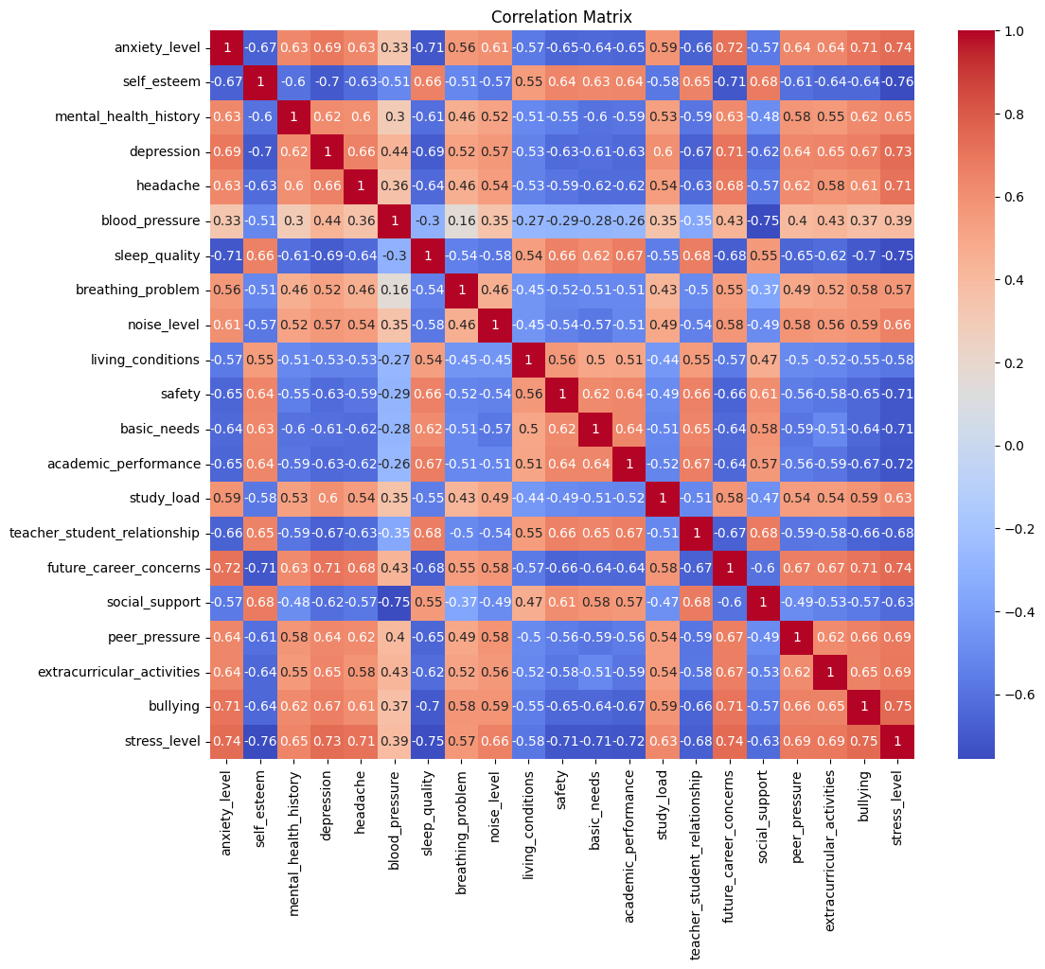
A correlation matrix is a square table that shows the correlation coefficients between two or more variables in a data set. The correlation coefficient measures the strength and direction of the linear relationship between the variables

Slide 10
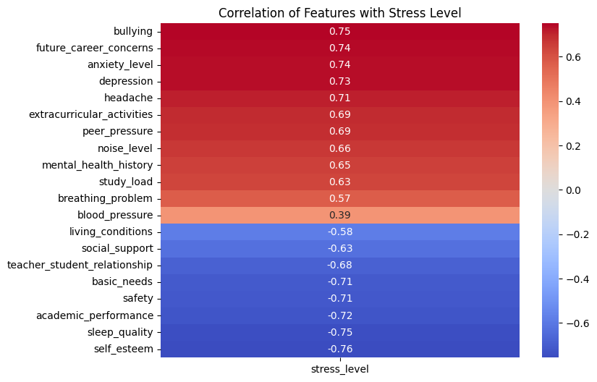
Correlation of stress with other variables

Slide 11
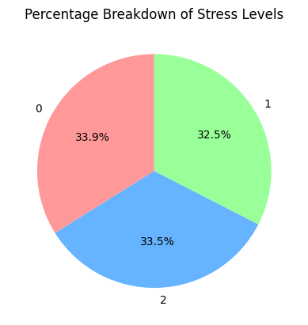
Percentage breakdown

Slide 12

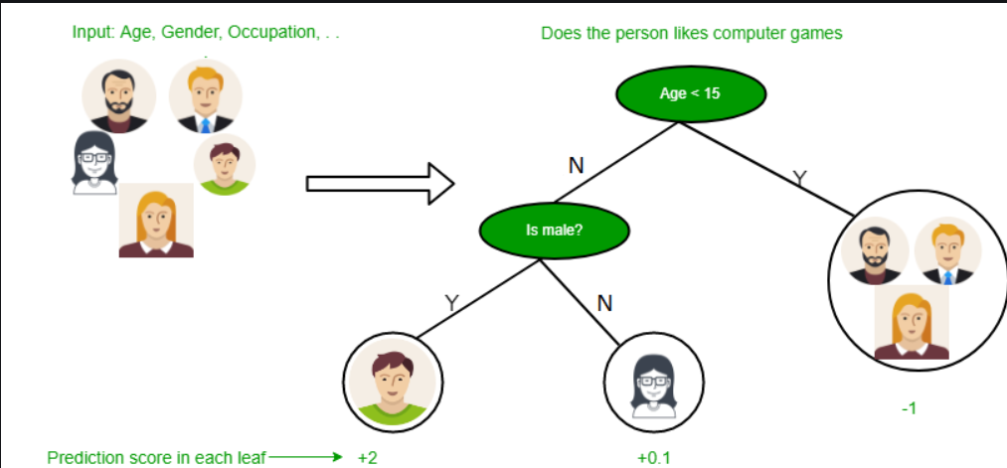
Decision tree
A decision tree is a type of supervised learning algorithm that is commonly used in machine learning to model and predict outcomes based on input data. It is a tree-like structure where each internal node tests on attribute, each branch corresponds to attribute value and each leaf node represents the final decision or prediction. The decision tree algorithm falls under the category of supervised learning. They can be used to solve both regression and classification problems.
The process of forming a decision tree involves recursively partitioning the data based on the values of different attributes. The algorithm selects the best attribute to split the data at each internal node, based on certain criteria such as information gain or Gini impurity. This splitting process continues until a stopping criterion is met, such as reaching a maximum depth or having a minimum number of instances in a leaf node.

Slide 13
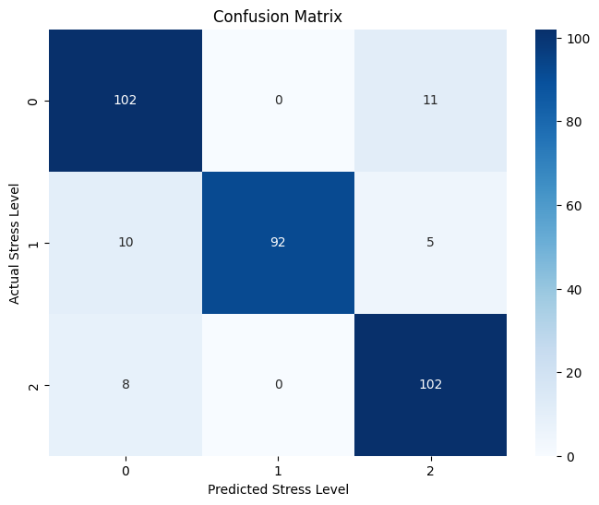
Confusion matrix

Slide 14
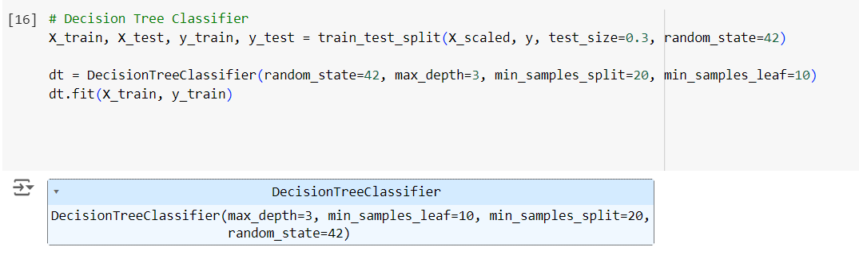
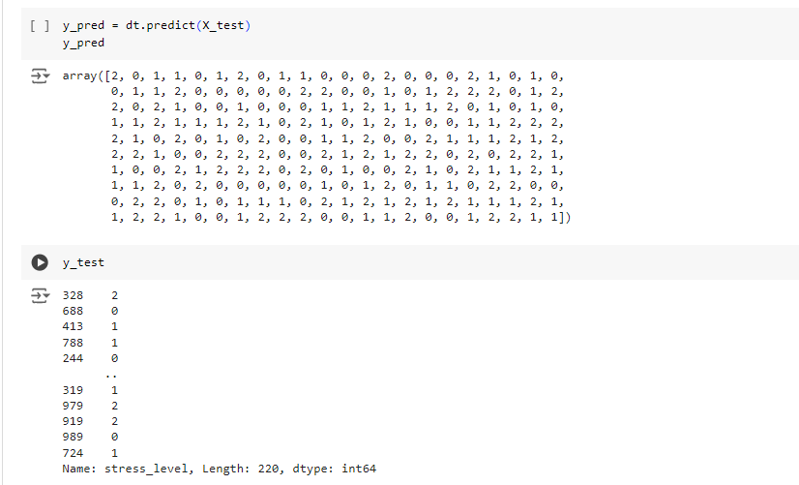
Result for decision tree

Slide 15

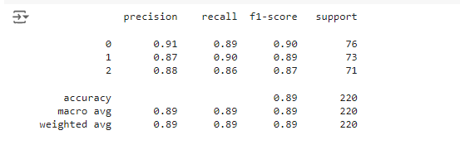
Result

Slide 16
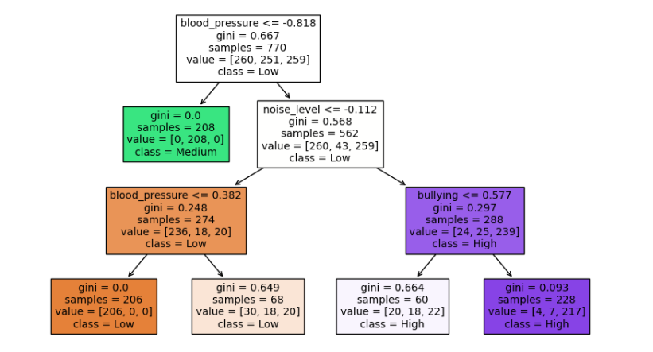
Decision tree

Slide 17
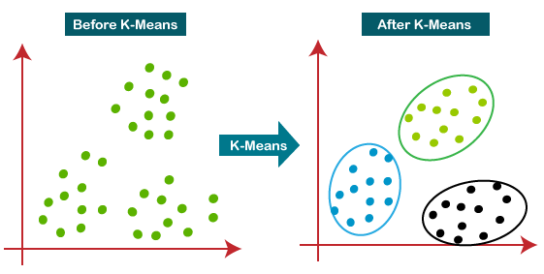
K-Means Clustering
K-Means Clustering is an unsupervised learning algorithm that is used to solve the clustering problems in machine learning or data science.
It allows us to cluster the data into different groups and a convenient way to discover the categories of groups in the unlabeled dataset on its own without the need for any training.
Here K defines the number of pre-defined clusters that need to be created in the process, as if K=2, there will be two clusters, and for K=3, there will be three clusters, and so on.

Slide 18
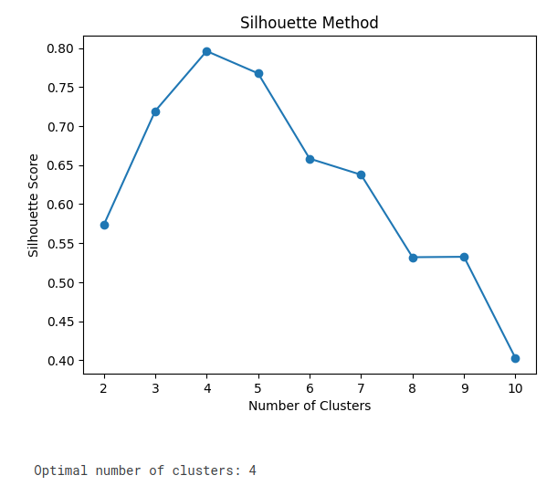
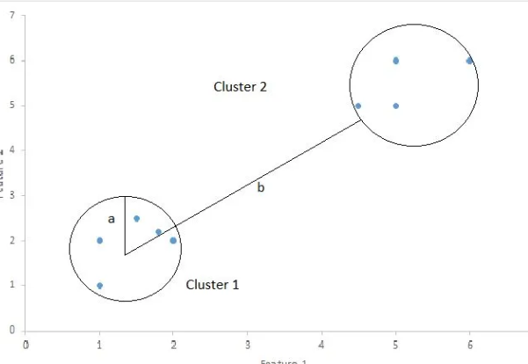
Silhouette Coefficient
Silhouette Coefficient or silhouette score is a metric used to calculate the goodness of a clustering technique. Its value ranges from -1 to 1.
1: Means clusters are well apart from each other and clearly distinguished.
0: Means clusters are indifferent, or we can say that the distance between clusters is not significant.
-1: Means clusters are assigned in the wrong way.
Silhouette Score = (b-a)/max(a,b)
where
a= average intra-cluster distance i.e the average distance between each point within a cluster.
b= average inter-cluster distance i.e the average distance between all clusters.

Slide 19
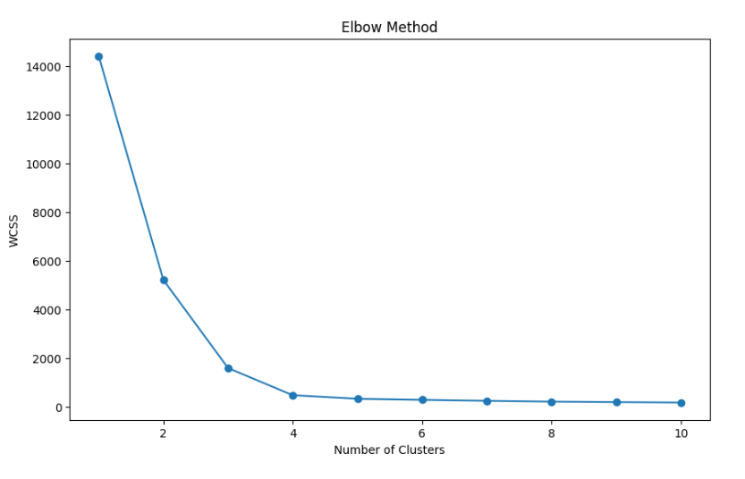
Elbow Method
The Elbow Method is a technique used primarily in clustering algorithms, like K-means, to determine the optimal number of clusters (K) in a dataset. It helps to find the value of K that best balances the trade-off between the complexity of the model (number of clusters) and the performance (how well the clusters fit the data).
Steps to Apply the Elbow Method
Run the Clustering Algorithm:
Perform K-means clustering for a range of values of K (e.g., from 1 to 10).
Calculate the Sum of Squared Errors (SSE):
For each value of K, calculate the SSE, also known as the Within-Cluster Sum of Squares (WCSS). This is the sum of the squared differences between each data point and its assigned cluster centroid.
SSE decreases as K increases because with more clusters, each cluster can be smaller and more tightly fitted to its members.
Plot the SSE against K:
Create a plot with the number of clusters (K) on the x-axis and the SSE on the y-axis.
Identify the "Elbow" Point:
The "elbow" point on the plot is where the rate of decrease sharply slows down. This point suggests that adding more clusters beyond this value doesn't significantly improve the fit of the model.
The optimal number of clusters is at this elbow point, where the reduction in SSE starts to level off.

Slide 20
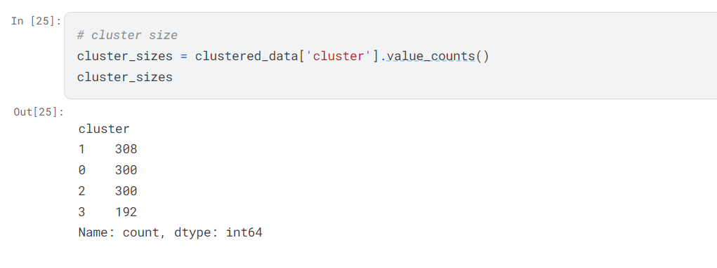
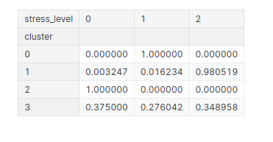
Result

Slide 21
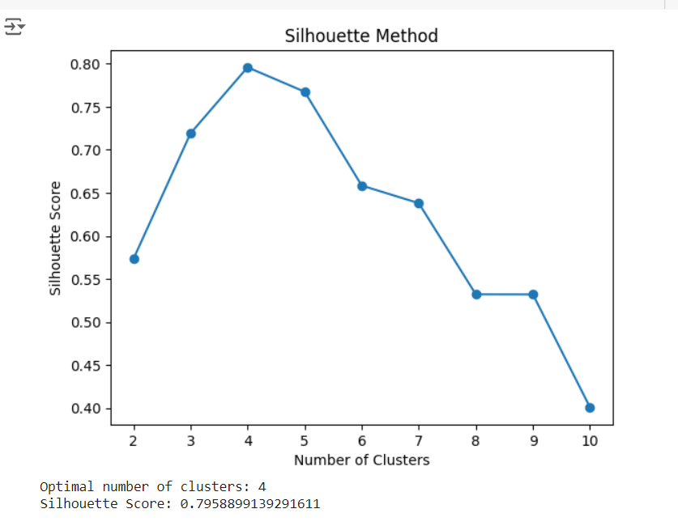

Slide 22
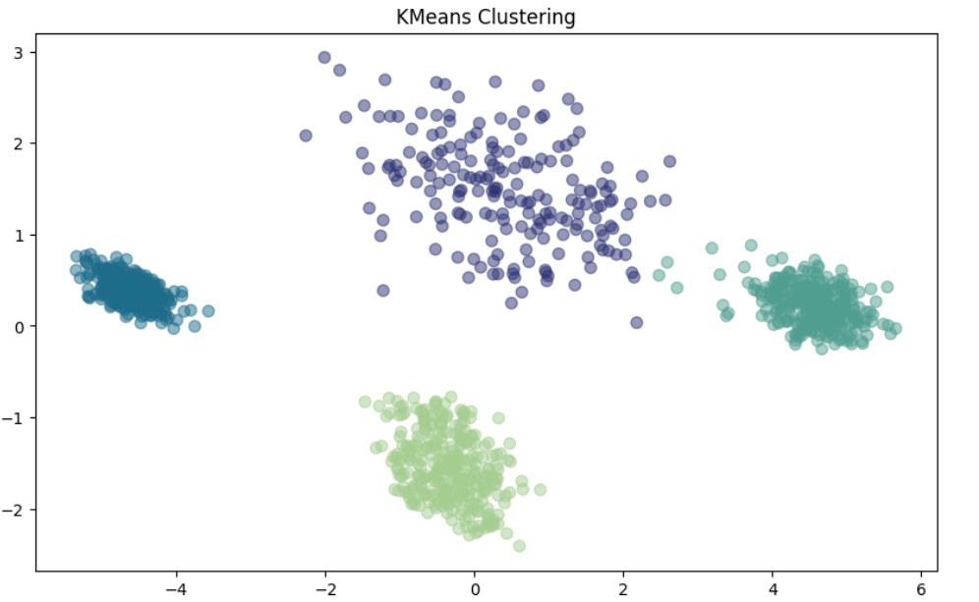

Slide 23
conclusion
After performing various machine learning techniques, we have identified the primary factors contributing to student stress: bullying and concerns about the future. To address this, we can implement measures to minimize bullying in schools and colleges. Additionally, counseling should be provided to students who are anxious about their future. By detecting stress levels early—where a level of 0 indicates normal stress and a level of 1 indicates the need for counseling—we can prevent stress from escalating to a level 2. Early intervention can help students manage their stress effectively, allowing them to concentrate better on their studies.

